Slide 1
SWDAT Digital Portfolio Submission
Pamela Painter
Senior
Creative High
Doodle Springs, MO
Art Area of Emphasis:
Digital Design
Painting
Instructor email: sample@samplemail.com

Slide 2
(2-D)
ALL Image Sizes no larger than 6”x 9” on Slide
Title: Shadows & Shapes
Medium: B/W Photography
Size: 1280 x 853 pixels

Slide 3
(2-D)
ALL Image Sizes no larger than 6”x 9” on Slide
Title: Rat Race (Digital Print)
Medium: Graphic Design (Computer Aided)
Size: 480 x 480 pixels

Slide 4
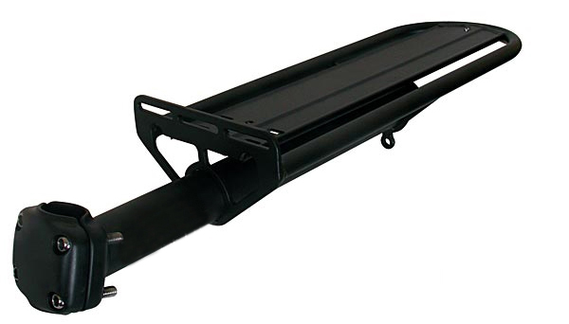
Documentation on solid background
(3-D)
3 multi view images
Please label A, B & C
(1 per slide)
ALL Image Sizes no larger than 6”x 9” on Slide
Title: Bike Rack (shot A)
Medium: Sculpture
Size: 4.25 x 13 x 3.75” [h x w x d]

Slide 5
Documentation on solid background
(3-D)
3 multi view images
Please label A, B & C
(1 per slide)
ALL Image Sizes no larger than 6”x 9” on Slide
Title: Bike Rack (shot B)
Medium: Sculpture
Size: 4.25 x 13 x 3.75” [h x w x d]

Slide 6
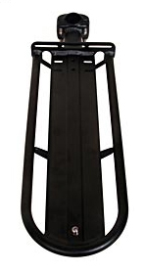
Documentation on solid background
(3-D)
3 multi view images
Please label A, B & C
(1 per slide)
ALL Image Sizes no larger than 6”x 9” on Slide
Title: Bike Rack (shot C)
Medium: Sculpture
Size: 4.25 x 13 x 3.75” [h x w x d]

Slide 7
Student Essay: 250 words minimum (12 pt font minimum)
Student Essay:
250 words minimum
(12 pt font minimum)

